Slide 1
BIOMARKER

Slide 2
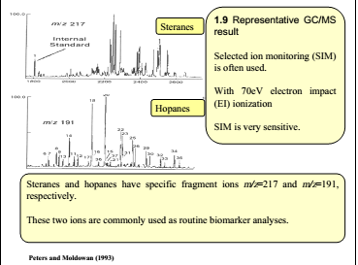

Slide 3
Steranes
Class of tetracyclic saturated biomarkers constructed from six isoprene subunits (C30), steranes originate from strols which are important membrane and hormone components in eukaryotic organisms (Peters et al., 2005). Steranes along with the hopanes were ones of the first groups of biomarkers to be used extensively in petroleum geochemistry (Philip, 2007). Most commonly used steranes are in the range (C26-C30) and are detected using M/Z 217 mass chromatograms (Peters et al., 2005).
In the earliest application it was commonly assumed that predominance of C27 steranes in an oil or rock extract would signify an algal or marine input whereas C29 steranes signified the presence of higher plant or terrestrial organisms (Philip, 2007).The sterols in eukaryotic organisms are precursors to the steranes in source rocks and petroleum (Mackenzie et al., 1982). Sterols are amphipathic and have dimensions similar to bacteriohopantetrol like bacteriohopanetetrol in prokaryotes (Peters et al., 2005). Sterols in living organisms show the following configuration: 8β, 9α, 10β(CH₃), 13β(CH₃), 14α, 17α(H), 20R (Peters et al., 2005).
. Steranes commonly used such as cholestane (27), 24-methylcholstane (C28), 24-ethylcholestane (C29) and diasterane. Many parameters can be calculated from this isomers steranes such as source, depositional environmental and thermal maturity.

Slide 7
1) Regular steranes/ 17α-hopanes
The regular steranes consists of C27, C28, and C29 ααα(20S+20R) and αββ(20S+20R) compounds and the 17α-hopanes consists of C29-C33 pseduohomologs including 22s and 22R epimers for C31-C33 homologs (Moldowan et al., 1985). Regular steranes/ 17α-hopanes reflects input of eukaryotic (Mainly algae and higher plants) versus prokaryotic (bacteria) organisms of the source rock (Peters et al., 2005). In general, high concentrations of steranes and high steranes/hopanes (1) typically marine organic matter with major configuration from planktonic and/ or benthic algae (Moldowane et al., 1985). Conversely low steranes and low steranes/hopanes are more indicative of terrigenous and/ or microbially reworded organic matter (Tissot and Welte, 1984). Connan et al. (1980) used low steranes/ triterpane (<0.05) and other molecular data for bitumen from anoxic. Carbonate - anhydrite facies offer prove of high microbial input. Use the ratio of steranes/ hopanes rather than steranes/triterpanes. Both ratios are of limited used because of the variety of organisms that contribute to seteranes and especially triterpanes (Peter et al., 2005).

Slide 9
The C27 sterols tends to be dominant in most plankton particularly in red algae and zooplankton (Hunt, 1996) while the C28 sterols may have derived from unicellular green algae such as parasynophytes or cholorophytes (Volkman, 1986). C29 is dominant in higher plants. Also C29 are dominant in brown algae and some species of green algae (Hunt, 1996). As it can seen from Table (4-1) the high values of C29, C27 denote marine algae carbonate source rock. Average C27/C29 sterane and steranes/hopane ratio,

Slide 10
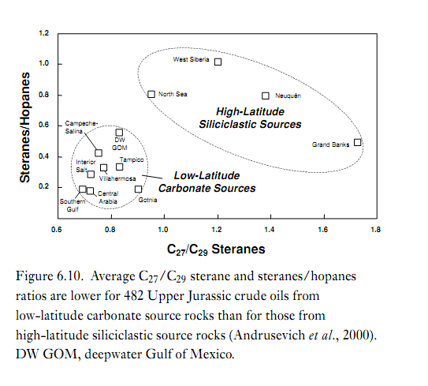

Slide 11
2) Diasterane (rearranged steranes (S1))
Rearrangement product from sterol precursors through diasteranes, the arrangement involves migration of C10 and C13 methylgroups to C5 and C14 and if favored by acidic conditions clay, catalysis and/ or high temperatures diasteranes increase relative to steranes with thermal maturation and they are low in clay-poor carbonate source rocks (Peters et al., 2005). Diasteranes are ultimately reduced to diasteranes (rearranged steranes) showing 13β, 17α(H) 20S and 20R (major isomers) and 13α, 17β(H) 20S and 20R (minor isomers) sterochemistries (Peters et al., 2005). The ratio of diasteranes/ steranes (S1/S6) or (rearranged/ regular steranes) are commonly used to distinguish petroleum from carbonate versus clastic source rocks (Mollo et al., 1988). In addition this ratio was commonly used to indicate the presence or absence of clay minerals necessary for conversion of steranes to diasteranes and also reflects oxicity/ anoxicity (Philip, 2007). Diasterane concentration in petroleum depends on anoxicity and pH of the depositional environment and clay content and thermal maturity in the source rock (Peters et al., 2005). High disterane/ steranes ratios are typical of petroleum derived from clay-rich source rocks. However, high of this ratio in some crude oil can result from high thermal maturity and/or heavy biodegradation (Seifert and Moldowan, 1978).

Slide 13
3) C27 – C28 – C29 steranes
. The distribution of C27-, C28-and C29- sterol homologs on a ternary diagram might be used to differentiate ecosystem steranes. Triangle plot of %C27, C28 and C29 steranes can be used for correlation of oil and bitumens (Peters et al., 2005).

Slide 14
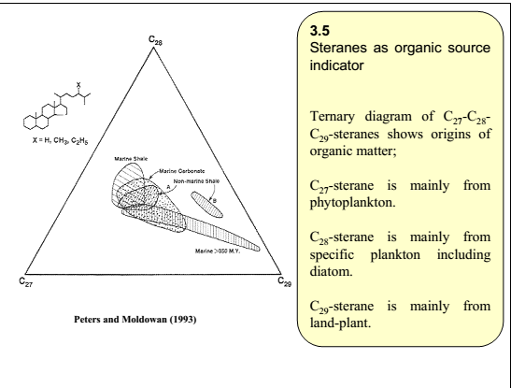

Slide 15
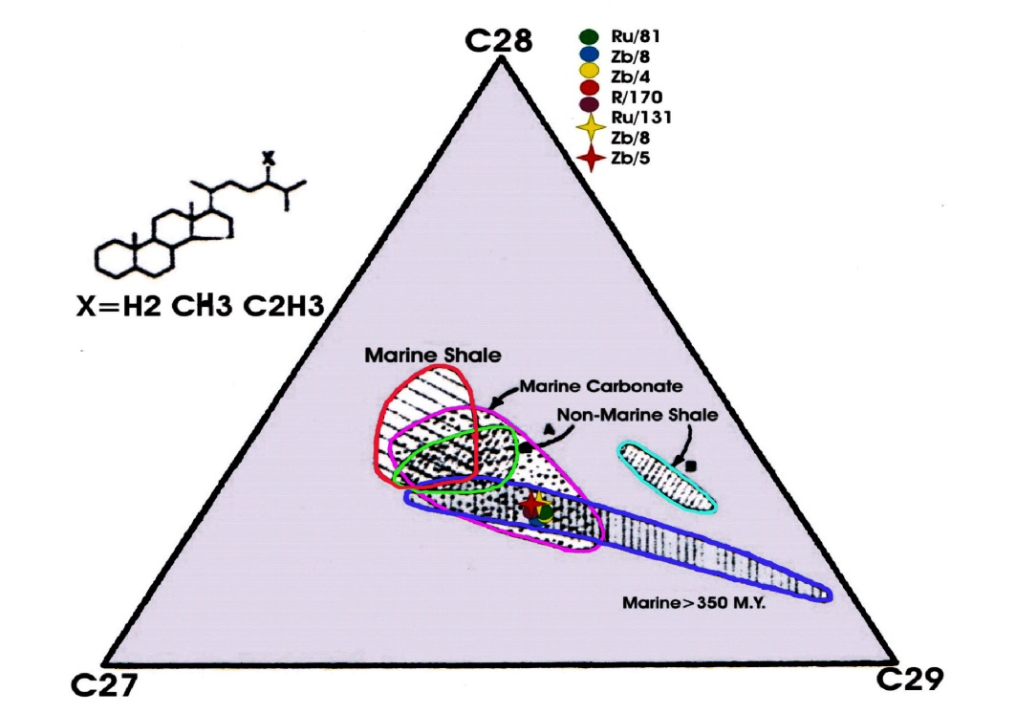

Slide 17
Porphyrins
Prophrins are complex tetrapyrrolic organometallic compounds that contain a great deal of Ni and V in crude oils (Philip, 2007) which are originated from various sources including chlorophyll and heme (Peters et al., 2005). Prophyrin structures have been related to chlorophyll-c in certain eukaryotic algae or chlorophyll-a which is widespread in eukaryotic algae and higher plant. A number of ratios based on prophyrin distributions have been used for characterizing depositional environments (Philip, 2007). For example the ratio of V/(V+Ni) prophyrins varies with redox conditions due to variations in both Eh and pH, low pH and Eh favor vanadyl prophyrins (Philip, 2007). The proportions of vanadyl and nickel prophyrins are used as source parameters in oil-oil and oil-source rock correlations (Lewan, 1984). Under low Eh conditions, sulfate reducing bacteria generate hydrogen sufide, high sulfide in the pore water of anoxic sediments cause nickel ion (Ni⁺²) to precipitate as nickel sulfide, leaving vanadyl ion (Vo⁺²) to complex with available free prophyrins. Low V/(V+Ni) prophyrin ratios in marine Toarcian rocks reflect oxic to suboxic conditions while high ratios reflect anoxic sedimentation (Moldowan et al., 1986).

Slide 20
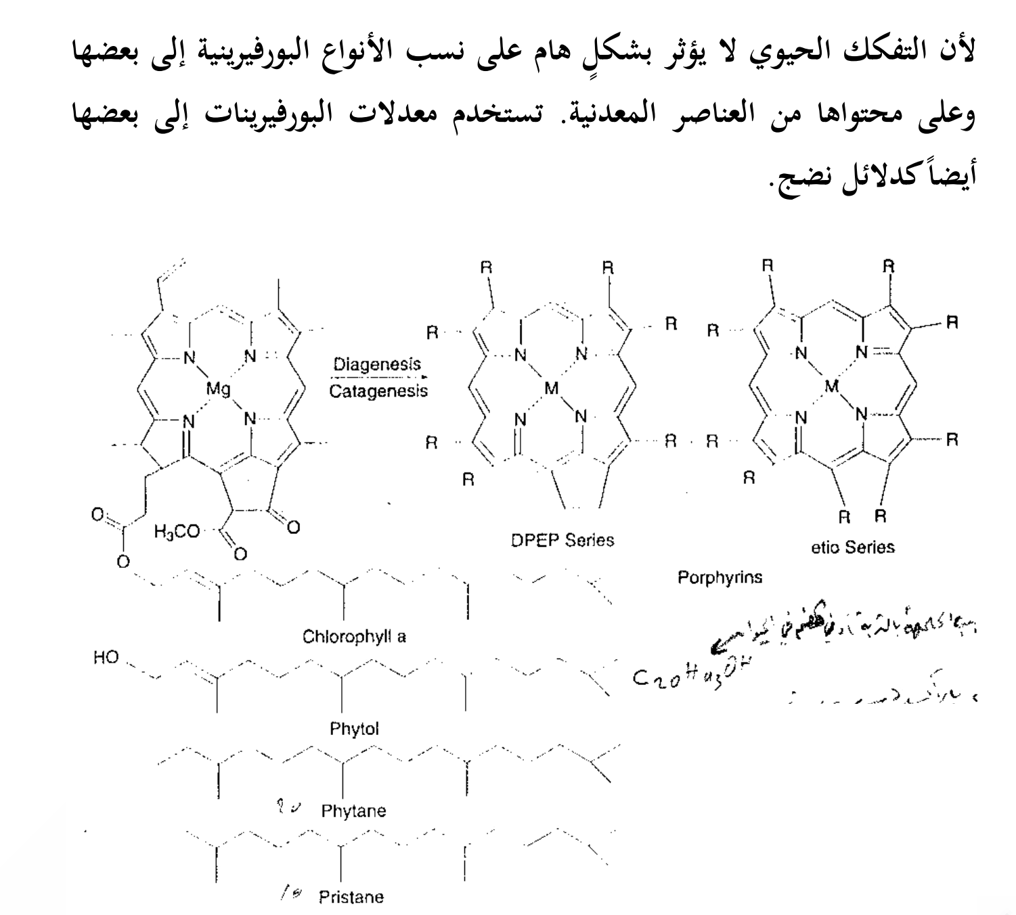

Slide 21
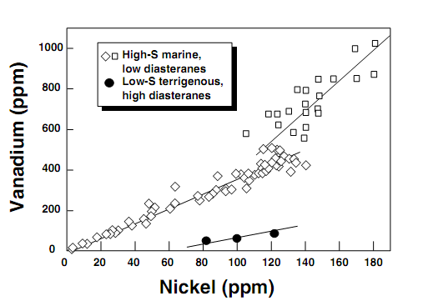

Slide 22
Aromatic Fraction
Organic compounds with one or more benzene rings in their structure including pure aromatic such as benzene and polycyclic aromatic hydrocarbons plus cycloalkano aromatics, such as monoaromitics steroids, some cyclic sulfur compounds such as benzothiophenes and porphyrins (Peters et al., 2005). Because of their high solubility, low-molecular-weight aromatics such as benzene and toluene are readily washed from petroleum by circulating groundwater, light aromatics are components in unleaded gasoline and are used as feedstocks for petrochemicals
The important biomarkers in petroleum are the alkylated naphthalene, phenanthrene, and chrysene aromatics, and the dibenzothiophene and benzonaphthothiophene sulfur-contianing aromatics (Frysinger and Ganies, 2001). Aromatic hydrocarbons can be divided into classes based on the number of aromatic rings, monoaroamtics have one rings, diaroomtics have two, triaromatics have three and so on (Peters et al., 2005). Collectivity, any aromoatic hydrocarbon that has two or more rings joined togather can be called a polynuclear aromatic hydrocarbon (PAH)
Aromatic biomarkers can provide valuable information on organic matter input, for example, aromatic hopanoids originate from bacterial precursors, while tetra-and pentacyclic aromatic with olennane lupane or ursnae skeletons indicate higher plants (Garrigues et al., 1986). There are many compounds of aromatic, such as:

Slide 23
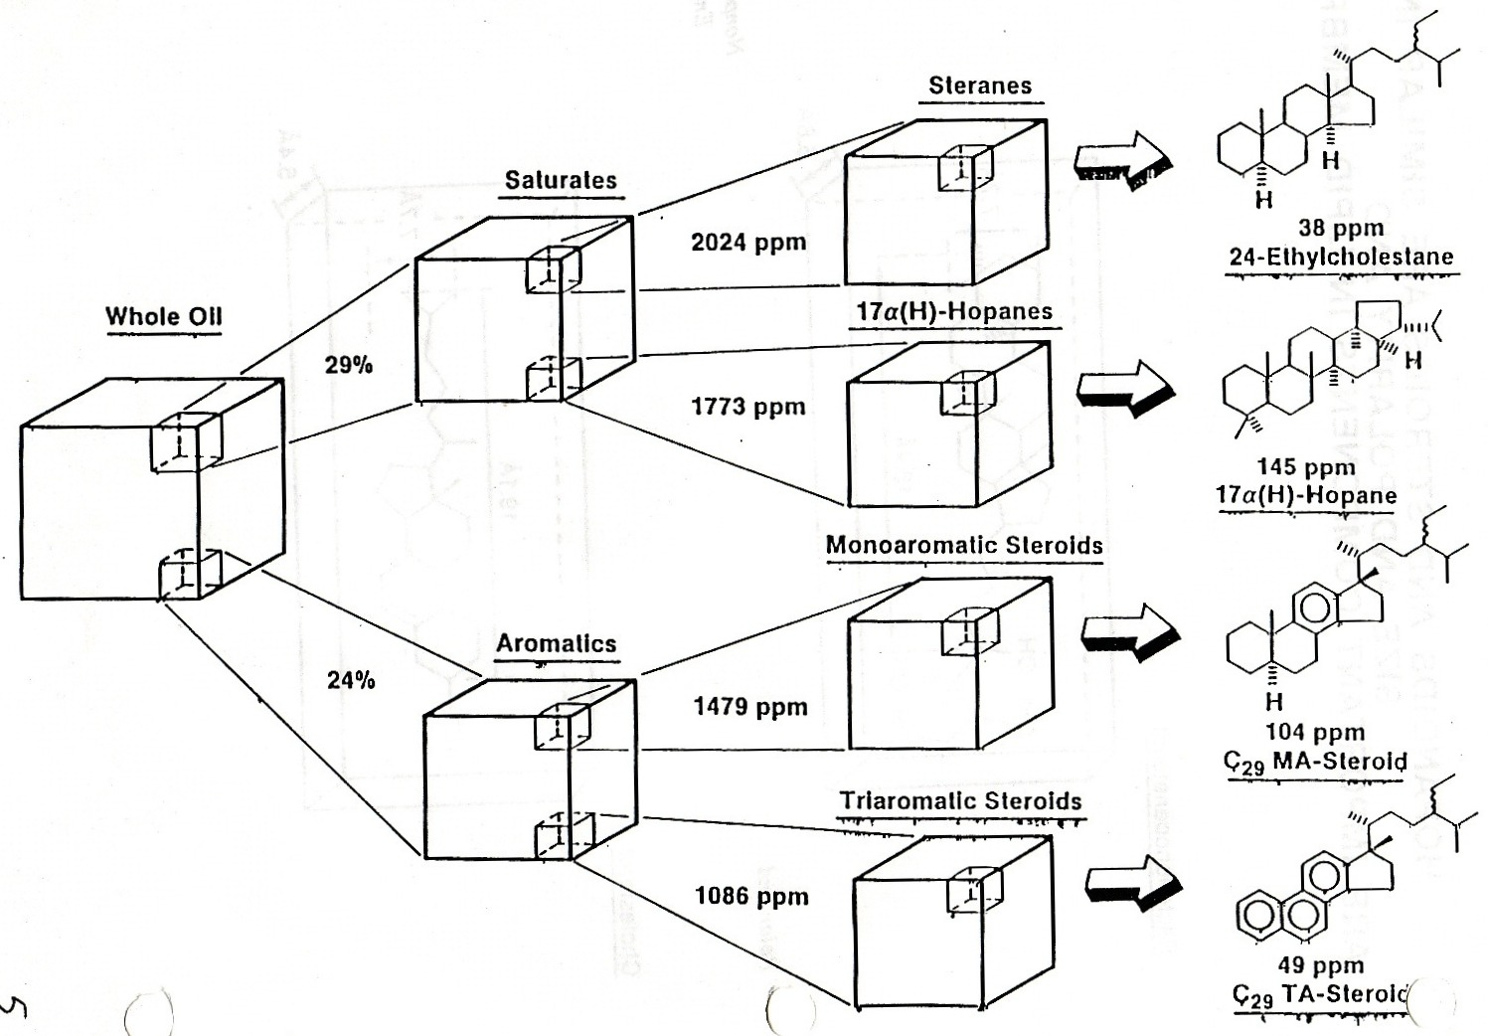

Slide 24
1) Organo sulphur compounds
Organo sulphur compounds can be divided into two main subcategories. These include the thiophene, benezothiophene, dibenzothiophene series and their methylatet analogues; and sulfur containing biomarkers such as steranes, hopanes and isoprenoid derivatives (Philip, 2007). Most of these compounds will be discussed along with their significance and potential uses:
A) Methyldiben zothiopheres (MDBT) and dibenzothiophenes (DBT)
The sulfur- bearing aromatics dibenzothiophene structures (dibenzothiophene, C0-C1-, C2-, C3 dibenzothiophene (Connan et al., 1986). The concentration of C0-C3 diobenzothiophenes in oil depends on the source-rock facies, high-sulfur kerogens from anoxic carbonate-evaporite source rock yield crude oil rich in C0-C3 dibensothiophene where low sulfur kerogens from clastic source rocks yield crude oils with low C0-C3 dibenzothiophenes (Hughes, 1984). Diboenzothiophenes concentration may decrease during refining (Peters et al., 2005).

Slide 27
The distribution of the methydibenzothiophes showed a V-shape distribution in carbonate derived oil but a star-Shape distribution in oil from silic clastic rocks (Philip, 2007). Oil derived from carbonate source rocks were observed to have an abundance of substituted dibenzothioph where those from silic clastic rocks had decreasing amounts of dimethyl and trimethyl-dibenzothiophenes (Philip, 2007). Although these distributions are based primarily on source effects, increasing maturity will tend to convert the methyl-dibenzothiophene isomers to the most thermodynamically favorable distribution (Philip and Lewis, 1987). The low content of organo sulphur compounds in the oils as reflected in the low dibenzothiophene/phenanthrane ratio (≤ 1) is consistent with fresh water depositional environment (Hughes et al., 1995). Several new maturity parameters were proposed based on the assumption that Alkyl DBT isomers with the methyl substituent in the 4-position are the most thermodynamically stable, whereas those with the substituent in the 1 position are of low stability (Philip, 2007).

Slide 28
2) Phenanthrenes (P) and methylphenanthrene (MP)(MP three ring aromatic hydrocarbon (M/Z 191)
Alkylated benzenes, nephtalenes, and phenanthrenes are commonly the most abundant aromatic species in crude oils (Peters et al., 2005). (C1-C2-C3-C4 phenanthrenes that most abundant in crude oils; the relative proportion of phenanthrens in the aromatic fractions of marine source rocks and crude oils were typically lower than observed for oils of terrigenous origin and source rocks (Fanpu et al., 1991).

Slide 29
3) Naphthalenes (N)
An aromatic hydrocarbon (C10H8) consists of two fused benzene rings (Peters et al., 2005). The abundant in crude oils C0-C4 naphthalenes, lighter oils and enriched in the naphthalenes, whereas heavy, degraded or weathered oils are enriched in larger –ring compounds (Peters et al., 2005). Naphthalenes decrease faster than other PAHs due to greater evaporation and water solubility. The C3-Naphthalenes to C3-phenanthrenes ratio is used for lighter crude oils in the early stage for weathering lower abundance of phenantherene compared to naphthalenes which is unusual for oils from silic clastic source rocks according to Fan et al. (1990). This inconsistency may be attributed to migration effect as Naphthalenes are characterized by high migration efficiency than phenanthrenes (Leythaeuser et al., 1988).

Slide 30
4) Fluorene (F)
Fluorene has two aromatic rings plus a five member rings. The additional ring contributes to the overall polarity of the molecule and therefore produces more retention on the polar second-dimension column. A GC×GC chromatogram region contains carbon substituted fluorenes (C1Fl, C2Fl) substituted phenanthrene (C1PH, C2PH) and substituted dibenzothiophenes (C1DBT, C2DBT) the fluorine bands correspond to the M/Z 180 (C1Fl) and M/Z 194(C2Fl) ElCs (Glenns and Gaines, 2001). The relative abundance fluorenes may serve as a good indicator for sedimentary environment of source rocks (Li et al., 2005). With respect to study area, in table (4-1), the values of fluroene are low indicating that the source rocks are marine carbonate.

Slide 31
5) Triaromatic steroids (TAS)
C26H32 aromatic hydrocarbons that originate from sterols including monoaroamtic and traroamtic steroids, triaromatic steroids hydrocarbons lack the α-methyl group of C-10. Further, the methyl group at C-13 in sterols is rearranged to C-17 in triaromatic steroids. Triaromatic steroids is a class of biomarkers containing three fused aromatic rings and one five-member naphthene ring (naphtheneophenanthrenes) probably derived from monoaromatic steroids during matruration (Peters et al., 2005). The distribution of triaroamtic steroids (M/Z 231) and monoaromatic steroids (M/Z 253) the increasing of the degree of thermal maturation of crude oil is accompanied by increasing the degree of aromaticity (Seifert and Moldowan, 1978). Consequently, the increasing of maturity levels of crude oils into the catagenesis stage converts monoaromatic steroids (MAS) to triaromatic steroids (TAS) lead to increasing the triaromatic steroids (Younes, 2001). Triaromatic steroids can be originated by aromatization and loss of methyl group (-CH3) from monoaromatic steroids can be converted to the C28 triaromatic steroids (Peters et al., 2005). Difference in relative abundances of triaromatic steroids may reflect differences in organic matter source input or sedimentary environments (Riolo et al., 1986).

Slide 32
Ratios of C26/(C26-C28), C27/(C26-C28) and C28/(C26-C28) triaromatic steroids are potentially effective source parameters, the triaromatic steroids ratios should be more sensitive to thermal maturation (Peters et al., 2005). The ratio of C26/C28 S and C27/C28 R triaromatic steroids can be used to distinguish oil families which refer that the oil represented as one petroleum system (Picha and Peters, 1998). Triaromatic steroids aromatization ratio [TA(I)/TA(I+II)] where [TA(I) = C20+C21 TAS; TA(II) = C26+C27+C28 TAS, 20S+20R isomers] increase from zero to 100% during thermal maturity (Peters et al., 2005).
For the crude oil of the study area, the ratio of TAS refers to marine carbonate rocks and one family group, Fig. (4-9).

Slide 33
